Slide 1
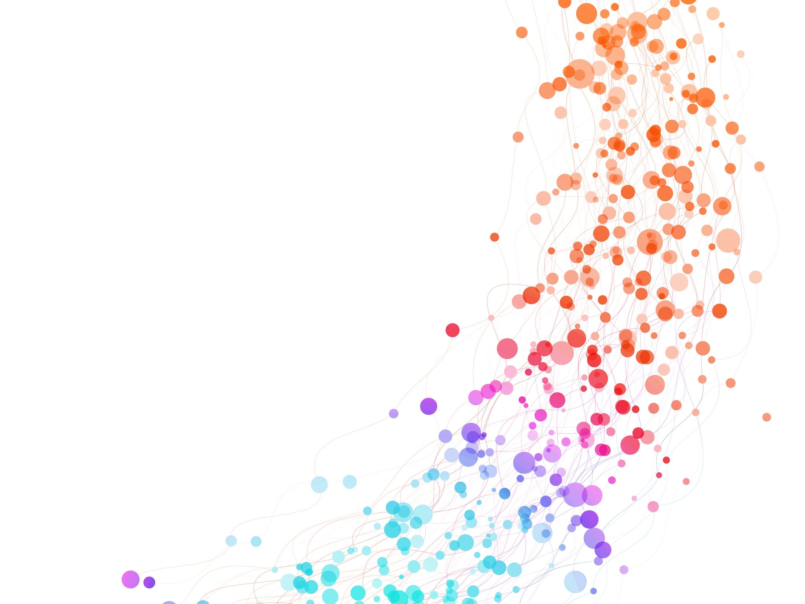
Data Analysis for SportsStats
Data Analysis Project Proposal for Olympics Dataset
Noviembre / 2021
Emer Isau Morales Vega

Slide 2
Overview
The data used for this analysis is the "SportsStats (Olympics Dataset - 120 years of data)" data set.
This dataset is made up of two files: athlet_events.csv and noc_regions.csv.
This data set was chosen because it reveals the Olympic medal award records for different sports categories, the countries that participated, names of the athletes, age, medals, etc.
Likewise, it can be said that the data is useful for news agencies that report on the different feats in the 120 years of the existence of the Olympic games.
Also, it can be of great importance for countries aspiring to improve their performance in subsequent Olympic events.

Slide 3
Import Data
Getting and Cleaning Data
Data analysis is done using python. The necessary resources are uploaded to google colab.
Here are some screenshots of how the data was imported into a Sqlite database

Slide 4
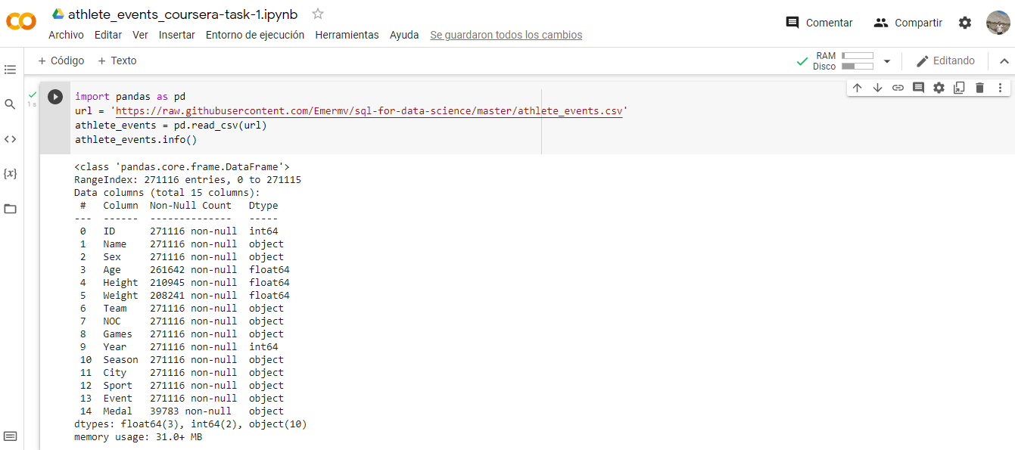
Import Data

Slide 5
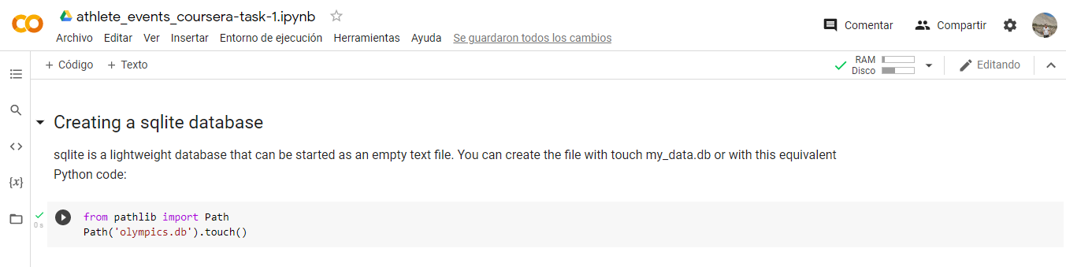
Create database

Slide 6
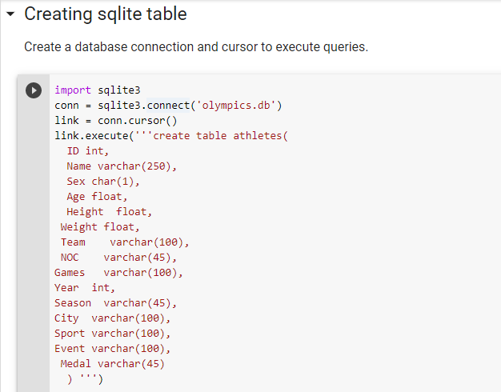

Create tables

Slide 7
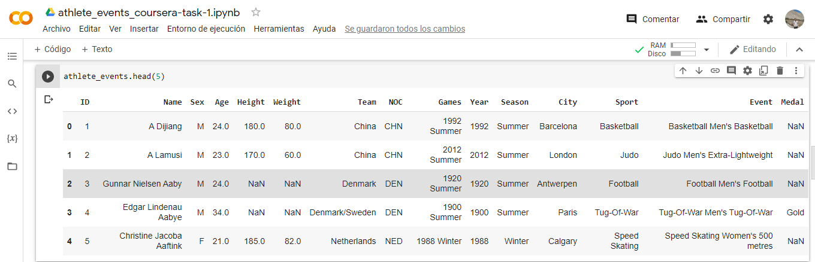
view data using python

Slide 8
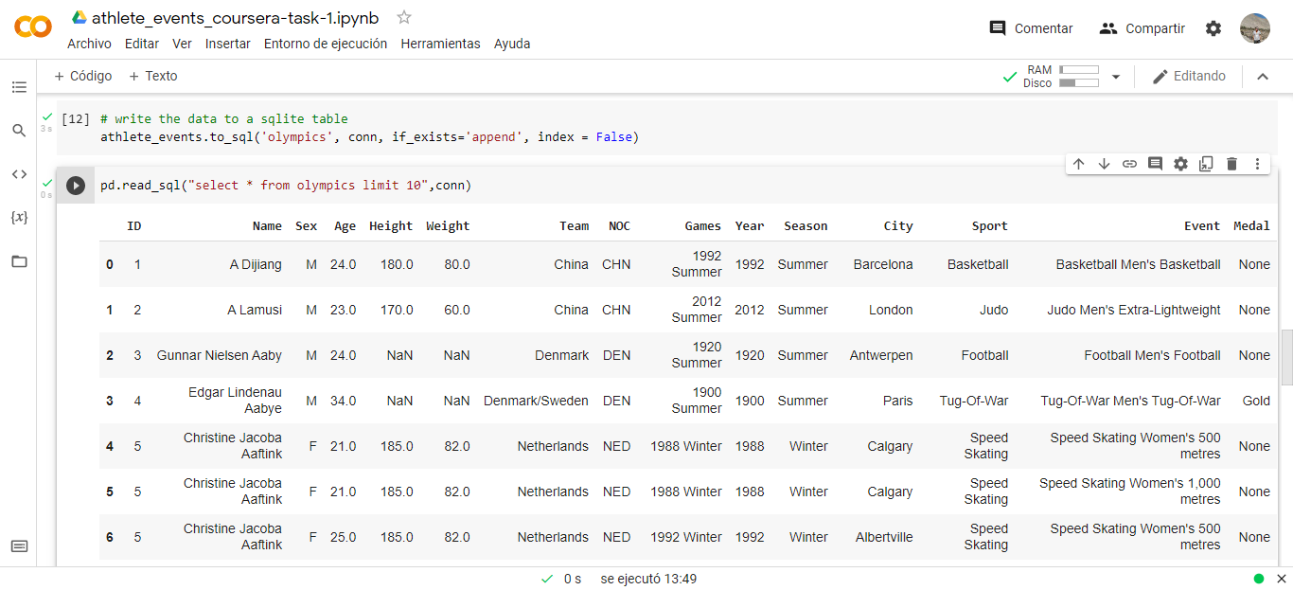
view data using SQL

Slide 9
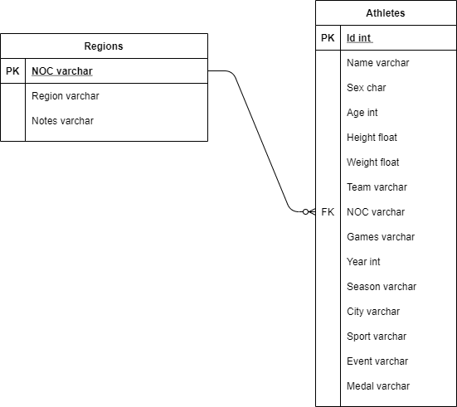
ERD

Slide 10
Questions to Answer
How many Peruvians won a gold medal?
Has Cristiano Ronaldo (CR7) won any medals?
Which sporting event gathered the most athletes?
In which year were the most gold medals awarded?
In the 120 years of the Olympic Games, which country's team won the most medals?
Which sport wins the most gold medals?

Slide 11
Initial Hyphothesis
How many Peruvians won a gold medal?
Of course there are Peruvians who won gold medals
Has Cristiano Ronaldo (CR7) won any medals?
I think that CR7 has won a gold medal
Which sporting event gathered the most athletes?
Without a doubt, football is the sporting event that gathers more athletes
In which year were the most gold medals awarded?
I believe that more gold medals were awarded between the years 2006 to 2010
In the 120 years of the Olympic Games, which country's team won the most medals?
From my perspective, Poland has more medals
Which sport wins the most gold medals?
I believe that the sport that has won the most gold medals in the 120 years of the Olympics is Boxing

Slide 12



Data analysis Approach
The working environment will be in google colab with the python programming language and sqlite will be used to analyze the data.
In the first instance, the files athlet_events.csv and noc_regions.csv that are related through the NOC column will be loaded. That is, the column exists in both files.
Then it will be necessary to remove or replace the NA values ​​for better analysis.
Finally, to answer the questions posed, statistical inference and graphic visualization will be used to determine if there is a relationship between the columns.

